Slide 1
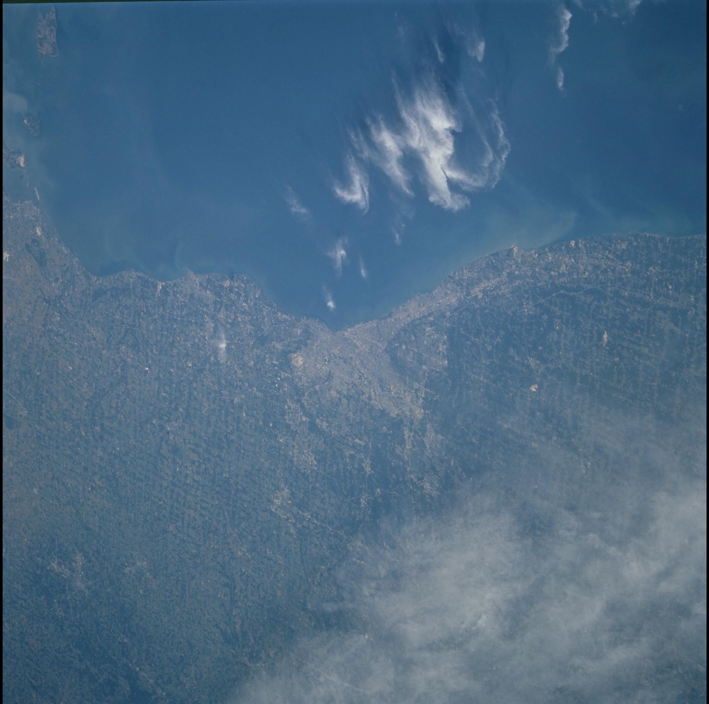
The Big Marble
NASA Space Apps Challenge 2013 - Cleveland

Slide 2
Team Members
Ryan Wilson
Dan Virost
Jeramiah Cieszynski
Nate Hodge
Matt Slagle

Slide 3
Challenge Overview
The Blue Marble
“Create an app, platform or website that consolidates a collection of space imagery and makes it more accessible to more people.”

Slide 4
Solution Overview
Provided a way for developers to more easily access the data by creating a public-facing RESTful API
Provided a way for anybody to more easily access the data by creating a website
Provided a way to push this data to the masses by creating a twitter handle

Slide 5
Solution Overview – cont.
RESTful API
Big Marble Website
Big Marble Twitter Account
Anything your heart desires!
SQL Database

Slide 6
Public API - Overview
RESTful API
Available NOW:
http://bigmarble.azurewebsites.net/api/
Thorough Documentation and Examples

Slide 7
Public API – Functionality
Given an address or location, will return all images containing that location
Detailed information about images
Location (Latitude and Longitude)
Mission
Features in Image

Slide 8
Public API - Example
IEnumerable<ImageData> GetImagesByAddress(string address)
Description: Returns all image data for a given street address. Uses the default range to search, with the street address as the center point.
api/image/?address=value
url example:
http://bigmarble.azurewebsites.net/api/image/?address=28500%20Clemens%20Rd,%20Westlake%20OH

Slide 9
Public API - Example
[TODO: Screen Shot of returned values]

Slide 10
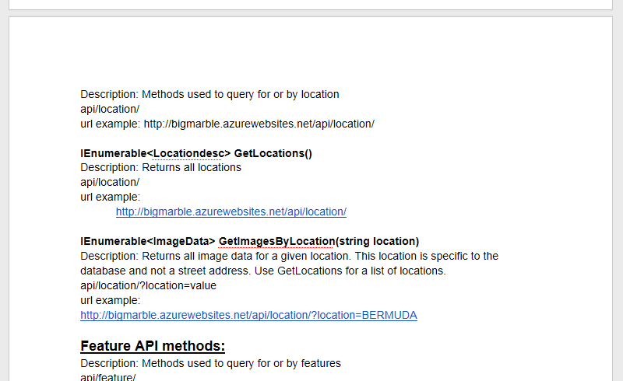
Public API – Documentation
Available now in a public Google Doc

Slide 11
Big Marble Website
http://bigmarble.azurewebsites.net/
[TODO: screen shot of main page]

